Slide 1
VADDE SHIVA SHANKAR
Final Project
3/21/2024 Annual Review

Slide 2
KEYLOGGER
AND
SEQURITY
3/21/2024 Annual Review

Slide 3


AGENDA
Introduction to Keyloggers
Problem statement
Project overview
Who are the end users?
Solution and its value proposition
The wow in your solution
Detection of Keyloggers
Prevention and Protection Strategies
Modelling
Results
3/21/2024 Annual Review

Slide 4

PROBLEM STATEMENT
A keylogger is a type of software that records keystrokes on a computer or device.
It can capture everything a person types, including passwords, messages, and sensitive information.
This poses a significant security risk as it can lead to unauthorized access to personal or confidential data.
When addressing a security problem statement related to keyloggers, it's crucial to highlight the potential risks they pose and the importance of implementing security measures to prevent their installation and operation.
3/21/2024 Annual Review

Slide 5

PROJECT OVERVIEW
Introduction:
The project aims to explore the impact of keyloggers on cybersecurity and develop strategies to mitigate the risks associated with these stealthy threats. By understanding how keyloggers operate and the vulnerabilities they exploit, the project seeks to enhance awareness and promote proactive security measures.
Objectives:
Investigate the functionality of keyloggers and their potential risks to personal and organizational security.
Analyze real-world case studies of keylogger attacks to understand the methods used by cybercriminals.
Evaluate existing cybersecurity measures and identify gaps that may leave systems vulnerable to keylogger infiltration.
Develop and test anti-keylogging software to detect and prevent keylogger attacks effectively.
3/21/2024 Annual Review

Slide 6

WHO ARE THE END USERS?
Ethical Hackers and Security Professionals:
Ethical hackers and security professionals may use keyloggers as part of penetration testing or security assessments to identify vulnerabilities in systems and applications. This helps organizations improve their security posture by addressing potential weaknesses before they can be exploited by malicious actors.
Cybercriminals:
Unfortunately, cybercriminals may also be end users of keyloggers, employing them for malicious purposes such as stealing sensitive information like passwords, financial details, or personal data. This stolen information can be used for identity theft, financial fraud, or other illicit activities.
3/21/2024 Annual Review

Slide 7

YOUR SOLUTION AND ITS VALUE PROPOSITION
Use Antivirus Software: Install reputable antivirus software on your devices to detect and remove keyloggers.
Keep Software Updated: Regularly update your operating system, applications, and antivirus software to ensure you have the latest security patches.
Be Cautious of Downloads: Only download software and files from trusted sources to minimize the risk of inadvertently installing keyloggers.
Use Strong Passwords: Create unique and complex passwords for all your accounts to make it harder for keyloggers to capture sensitive information.
3/21/2024 Annual Review

Slide 8

THE WOW IN YOUR SOLUTION
Antivirus software: Keep your devices safe with powerful antivirus software that detects and removes sneaky keyloggers. It's like having a superhero protecting your data!
Fort Knox Passwords: Create strong and unique passwords for your accounts, making it nearly impossible for keyloggers to crack. Your accounts will be as secure as Fort Knox!
Double Defense: Enable two-factor authentication for an extra layer of security. It's like having a secret code that only you know, keeping your accounts safe from keyloggers.
Phishing-Proof Shield: Stay vigilant against phishing attempts by avoiding suspicious links and messages. You'll be the master of detecting and avoiding those sneaky phishing traps!
3/21/2024 Annual Review
8

Slide 9
MODELLING
Import Required Modules:
Use Python's keyboard module to capture keystrokes.
Optionally, use other modules for logging, encryption, or network communication.
Set Up Logging:
Configure logging settings to specify the format and destination of log files.
Define Keylogger Function:
Create a function to capture and log keystrokes.
Use the keyboard.on_press() method to register a callback function to capture each key press event.
Main Function:
Create a main function to start the keylogger and keep it running indefinitely.
Testing and Deployment:
Test the keylogger program to ensure it captures keystrokes correctly.
Deploy the keylogger on target systems if necessary, ensuring compliance with legal and ethical considerations.
3/21/2024 Annual Review
9

Slide 10
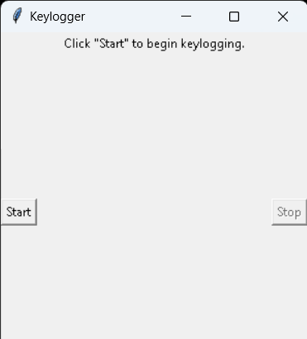
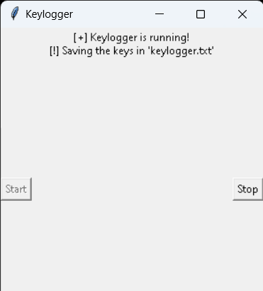
RESULTS
The result of a keylogger program typically involves capturing and logging keystrokes entered by a user on a keyboard. These logged keystrokes can then be used for various purposes, depending on the intent of the keylogger user. The covert nature of keyloggers allows them to capture sensitive information, including passwords, personal messages, and financial details, without the user's knowledge or consent. This poses serious risks to individuals, organizations, and society at large, including identity theft, financial fraud, and unauthorized access to confidential data.
3/21/2024 Annual Review
10

Slide 11
Project title
https://github.com/shivashankar01/keylogger.git

